Slide 1
Web Programming Language
Week 1
Introduction & HTML

Slide 2
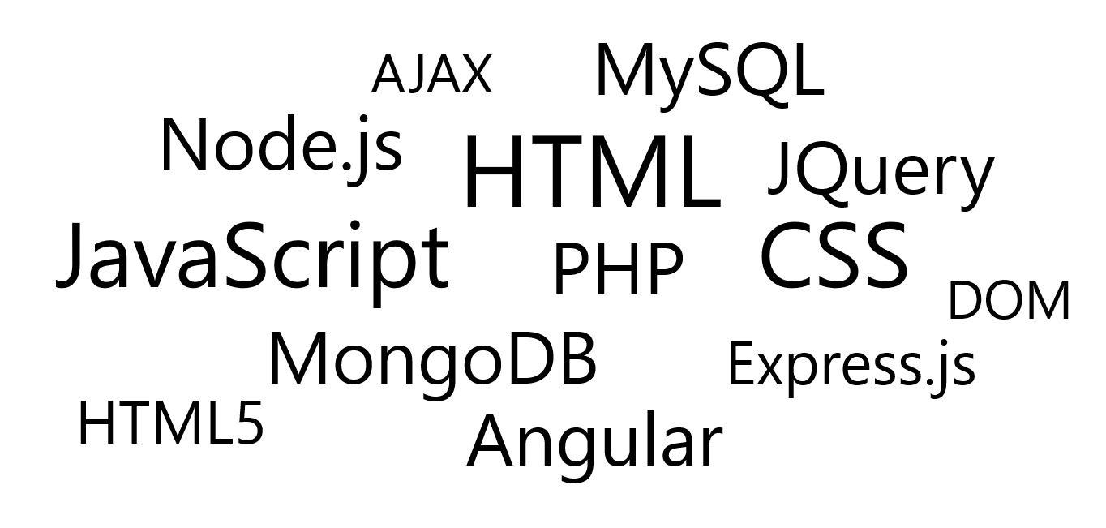
269200 Web Programming Language(s)

Slide 3
Why Study “Web Programming”
Or Web Development…
Build your own projects
Prepare for Senior Project!
Freelance
Become a developer (in Chiang Mai & beyond)
Consultancy
Create / Use APIs
Hobby

Slide 4
Front End? Back End? Full Stack?
Front-End
Client Side (HTML, CSS, JavaScript)
Front-End Framework
Back-End
Databases, APIs, Services
Full Stack
Everything!

Slide 5
Credit
Web Development In 2022 - A Practical Guide
A lot of technologies mentioned (name dropped)
This is a BIG field
We can really only cover a taste of it

Slide 6
SUMMARY
Basic Tools
Fundamentals – HTML / CSS
Front End Language
JavaScript
Development / Deployment Tools
Server Side Language
PHP, Node.js
Back-End / Front-End Framework
React

Slide 7
Basic Tools
Computer & OS
Windows, Linux, Mac
Text Editor / IDE
Sublime Text, VSCode, Dreamweaver(555), Eclipse
Browser
Chrome, Firefox…….., Safari, Opera, IE
Terminal
Git Bash…
Design
Photoshop…

Slide 8
Web Fundamentals
HTML & CSS
Hypertext MarkUp Language (5)
HTML5 is the current standard that defines HTML.
Everything we do now should conform to the HTML5 standard.
Semantic Tags
<!DOCTYPE html>
Cascading Style Sheets
Colors
Fonts
Positioning
Box Model
Grid / Flexbox

Slide 9
CSS Frameworks vs Custom CSS Components
A CSS Framework
Bootstrap (or Tailwind, Materialize, Bulma)
Make CSS positioning easier
Custom CSS Components
Only include the CSS you need – a personal mini reusable framework
Sass (Syntactically Awesome Style Sheets)
Designs should be Responsive!
Mobile First vs Mobile Last?

Slide 10
JavaScript! (Vanilla)
THE programming language of the browser
Also core language of Node.js, React etc.
Fundamentals (Variables, Types, Functions, Classes, Control Structures)
DOM (Document Object Model)
JSON (JavaScript Object Notation)
Fetch API
AJAX (Asynchronous JavaScript and XML)
JQuery

Slide 11
Development Tools
Git
Version Control (Github, Bitbucket)
Browser DevTools
Chrome / Firefox
NPM / Yarn
JavaScript Package Managers for Node.JS
Alternatives like Composer for PHP

Slide 12
Deployment Tools
Domain Name Registration
Namecheap, Google Domains…
Managed Hosting
Hostgator, Bluehost…
Hosting
Linode…
FTP/SFTP
File Transfer Protocol

Slide 13
“Basic Front End Developer”
Build websites for individuals & small businesses
Create mobile friendly layouts
Create CSS animations & effects
Work with a CSS framework
Dynamic page functionality
Small client side JS apps
Browser dev tools
Git for version control
Deploy / maintain small projects

Slide 14
Where Next?
Server Side Language
PHP, Node.js, Ruby, Python, C#, Go, Java, Rust…
Frontend JS Framework
React, Vue, Angular…

Slide 15
Server Side Language
Back-End developer / Full Stack
Node.js – technically not a language (JavaScript Runtime)
Fairly new
Fast
JS Everywhere
Part of the MEAN Stack
PHP – Hypertext PreProcessor
Easy to learn
Easy to set up
Backbone of many server side frameworks and software (Wordpress, Laravel)
Part of the WAMP/LAMP/MAMP Stack

Slide 16
Server Side Framework
PHP – Laravel, Symfony, Slim
Node.js – Express, Koa, Adonis, Feathers.js, Nest.js
Ruby – Ruby on Rails, Sinatra
Python – Django, Flask

Slide 17
Apps
Content Management Systems (CMS)
Wordpress
Drupal
E-Commerce
Woocommerce
Magento

Slide 18
Database
Relational Database
MySQL (Part of WAMP stack)
phpmyadmin
NoSQL
MongoDB (Part of MEAN stack)
compass
Cloud Database
Firebase, AWS

Slide 19
Front-End Framework
Reusable components, more interactive user interfaces
React
Popular, relatively easy to learn
Vue
Growing popularity, Fairly easy to learn
Angular
Used in a lot of enterprises, Steep learning curve
Svelte
New growing popularity

Slide 20
Where Next?
Mobile Development?
Flutter
React
Ionic

Slide 21
Introducing HTML
Basic HTML Tags
HTML Tables
Images & HTML Attributes
Hypertext & Links
HTML Comments

Slide 22
HTML
Hypertext Markup Language
Text & Tags
Opening Tag: <HTML> or <html>
Closing Tag: </HTML> or </html>

Slide 23
My First Page
<!DOCTYPE html> <html> <head> <title>My First Webpage</title> </head> <body> Hello World! </body> </html>

Slide 24
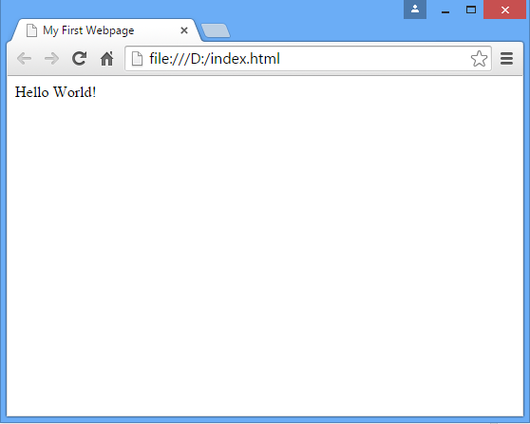
My First Webpage

Slide 25
Key Tags
<html>…</html> - Everything inside is HTML
<head>…</head> - Contains header data, which doesn’t appear on the page
<body>…</body> - Contains the parts that appear in the browser
<title>…</title> - Appears on the browser toolbar

Slide 26
Tip : View Source
Or, Ctrl-U in Chrome

Slide 27
Basic HTML Tags
<p>….</p> | P is for paragraphs, and is used to define a text into paragraphs. By default the browser will add some space (or a margin) before and after each <P> tag.
<h1>…</h1> <h2>…</h2> <h3>…</h3> <h4>…</h4> <h5>…</h5> <h6>…</h6> | A variety of headings can be easily added to a page using the tags from <H1> to <H6>. These tags highlight text into different sizes depending on which level heading is used.
<em>…</em> <i>…</i> | <EM> can be used to stress emphasis, or to highlight a piece of text, by default making it appear like italics.
<strong>…</strong> <b>…</b> | Strong tags can be used to highlight important text, or make it appear bold.
<ul> <li>…</li> <li>…</li> </ul> | <UL> is used to create an unordered list of something, and the list will consist of list items <LI>

Slide 28
Subtle Difference?
What is the difference between <strong> and <b>?
What is the difference between <em> and <i>?

Slide 29
Subtle Difference?
What is the difference between <strong> and <b>?
<b> or “Bold” defines how the text should appear, <strong> indicates it is more significant that the surrounding text…
What is the difference between <em> and <i>?
<i> or “Italic” defines how the text should appear, which <em> indicates it should be “emphasized”…
Consider a browser for a blind person?

Slide 30
HTML Tables
<table> <tr> <td>Country</td> <td>Capital</td> <td>Population</td> </tr> <tr> <td>Thailand</td> <td>Bangkok</td> <td>67 Million</td> </tr> </table>

Slide 31
Tables Tip
Don’t use tables for layout!
Tables often use more bytes of markup, making pages take longer to download.
The browser needs to download most of a table before it can render any of the page.
Tables can make website maintenance and particularly redesign much more complicated.
Tables can make content inaccessible to screen readers.
Tables can break text copying.
In short, tables weren’t meant for page layouts, but they ARE meant for displaying tabular data!

Slide 32
Images & HTML Attributes
<img src=”img/picture.jpg” alt=”company logo” style=”width:300px;height:300px”>
“src” attribute
Relative Link

Slide 33
Hypertext & Links
<a href=”http://www.example.com” target=”_blank”>link here</a>
<a href=”#html-linking”>Go to the HTML Linking Section</a>
Href attribute
Absolute Link
Open in new tab
Link to somewhere on the page

Slide 34
HTML Comments
<!--This is a comment --> <!-- <img src=”img/test.jpg”> Don’t show this yet! -->

Slide 35
Key Points
HTML (Hyper Text Markup Language) is used to create simple webpages.
An HTML page consists of text and tags, with tags instructing a browser what to do with the text.
Opening tags, such as <html>, are matched with closing tags, such as </html>.
Some HTML tags are used to define the structure of the document, such as <head> and <body>.
Some HTML tags instruct the browser how text should be displayed, such as <strong> or <i>.
The table tags can be used to display tabular data on a page.
Pictures can be included on a webpage using the <img> tag, which has no closing tag.
Some tags, such as the <img> tag need attributes, or parameters, to give the browser more information such as how big the image should be, or where the file is located.
The anchor tag, <a>, is used for creating links.

